Slide 1
Using OCaml
Duan Kaiqiang
2015/06

Slide 2
Guide
Ocaml Basis
Functional Programming
Why Ocaml
Library Quick Look
Cautions

Slide 3



Values = Functions + Variables
Functions
The very basic language element in OCaml.
Everything is function.
Variables
Special functions with no arguments, in fact.
Currying

Slide 4
Types and Type Inference
Basic Types
int float string bool
+ +. ^ &&
Complex Types
List Tuple Option
Self-defined Types: Variant Record
Type Inference

Slide 5
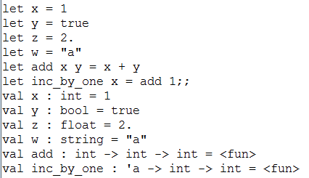
Examples
Basis

Slide 6





Examples
Lists
Tuples
Options

Slide 7


Examples
Variants
Records

Slide 8
Guide
Ocaml Basis
Functional Programming
Why Ocaml
Library Quick Look
Cautions

Slide 9

Everything is function
0 argument
1 or more arguments
Functions as arguments

Slide 10
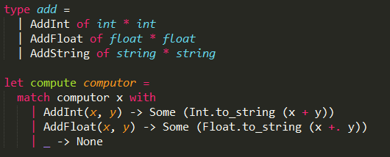
Pattern Matching

Slide 11
Guide
Ocaml Basis
Functional Programming
Why Ocaml
Library Quick Look
Cautions

Slide 12
Chaos?
Functional
Imperative
Modules
Exceptions
Object-Oriented

Slide 13
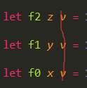
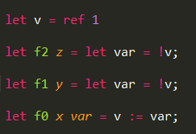
An Example
Functional
Imperative

Slide 14
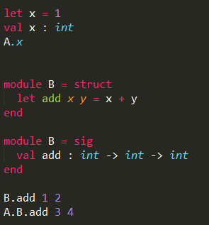
Module
ml & mli

Slide 15


Exceptions
Simple exception
Exceptions with messages

Slide 16

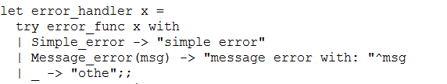


Exceptions
Handle an exception
A function to raise exceptions
A function to handle exceptions
Test the functions

Slide 17
More
完整自洽
类库丰富
社区支持
包管理
工业级语言

